Slide 1
Machine learning with scikit-learn
S U P E R V I S E D L E A R N I N G W I T H S C I K I T- L E A R N
George Boorman
Core Curriculum Manager, DataCamp

Slide 2
What is machine learning?
Machine learning is the process whereby:
Computers are given the ability to learn to make decisions from data
without being explicitly programmed!

Slide 3
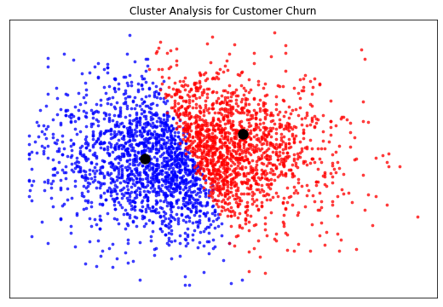
Unsupervised learning
Uncovering hidden patterns from unlabeled data
Example:
Grouping customers into distinct categories (Clustering)

Slide 4
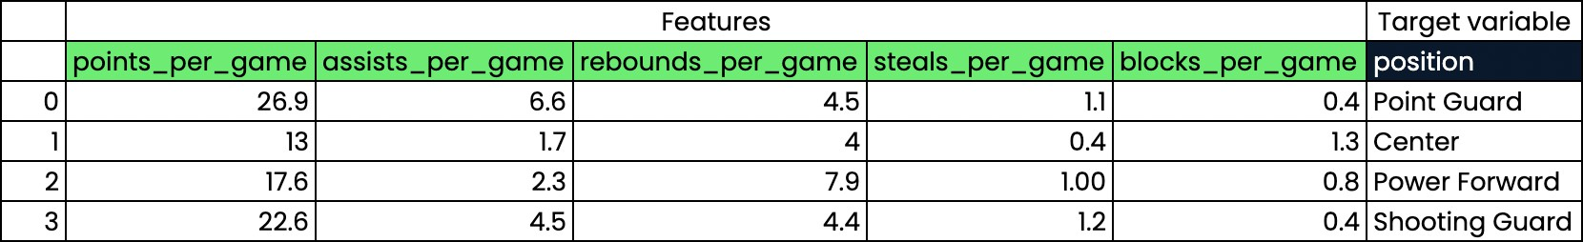
Supervised learning
The predicted values are known
Aim: Predict the target values of unseen data, given the features

Slide 5

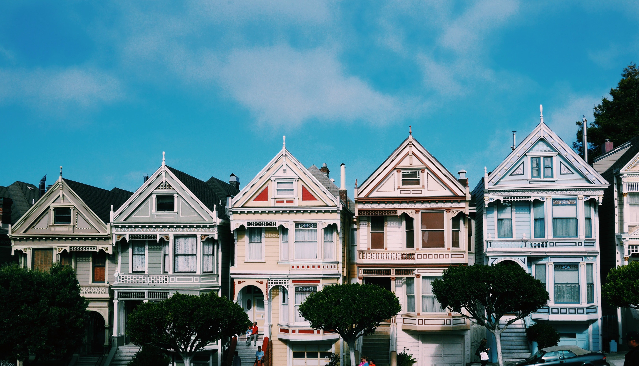
Types of supervised learning
Classification: Target variable consists of categories
Regression: Target variable is continuous

Slide 6
Naming conventions
Feature = predictor variable = independent variable Target variable = dependent variable = response variable

Slide 7
Before you use supervised learning
Requirements:
No missing values
Data in numeric format
Data stored in pandas DataFrame or NumPy array
Perform Exploratory Data Analysis (EDA) first

Slide 8
scikit-learn syntax
sklearn.module model = Model() model.fit(X, y)
Model
predictions = model.predict(X_new) print(predictions)
array([0, 0, 0, 0, 1, 0])

Slide 9
The classification challenge
S U P E R V I S E D L E A R N I N G W I T H S C I K I T- L E A R N
George Boorman
Core Curriculum Manager, DataCamp

Slide 10
Classifying labels of unseen data
Build a model
Model learns from the labeled data we pass to it
Pass unlabeled data to the model as input
Model predicts the labels of the unseen data
Labeled data = training data

Slide 11
k-Nearest Neighbors
Predict the label of a data point by
Looking at the k closest labeled data points
Taking a majority vote

Slide 12
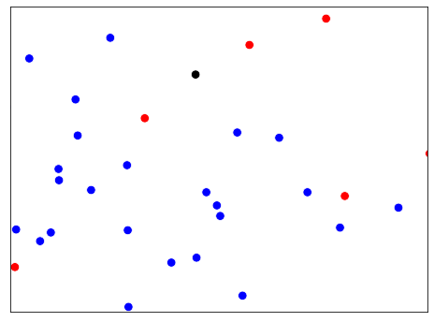
k-Nearest Neighbors

Slide 13
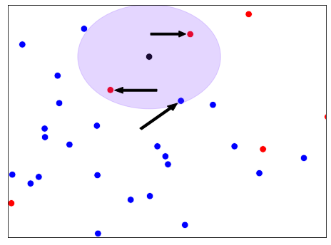
k-Nearest Neighbors

Slide 14
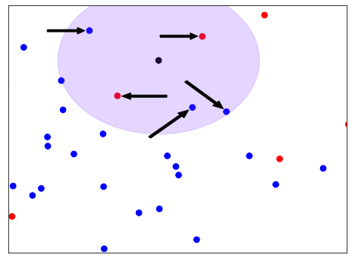
k-Nearest Neighbors

Slide 15
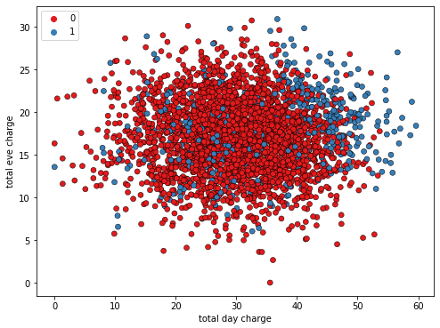
KNN Intuition

Slide 16
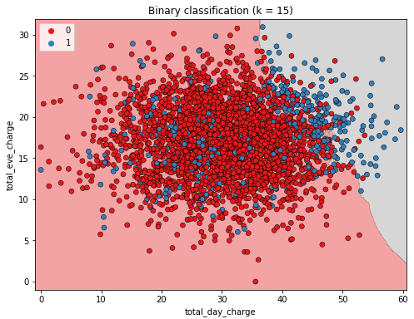
KNN Intuition

Slide 17
Using scikit-learn to fit a classifier
sklearn.neighbors KNeighborsClassifier
X = churn_df[["total_day_charge", "total_eve_charge"]].values y = churn_df["churn"].values
print(X.shape, y.shape)
(3333, 2), (3333,)
knn = KNeighborsClassifier(n_neighbors=15) knn.fit(X, y)

Slide 18
Predicting on unlabeled data
X_new | = | np.array([[56.8, | 17.5],
 |  | [24.4, | 24.1],
 |  | [50.1, | 10.9]])
print(X_new.shape)
(3, 2)
predictions = knn.predict(X_new) print('Predictions: {}'.format(predictions))
Predictions: [1 0 0]

Slide 19
Measuring model performance
S U P E R V I S E D L E A R N I N G W I T H S C I K I T- L E A R N
George Boorman
Core Curriculum Manager, DataCamp

Slide 20
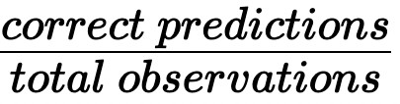
Measuring model performance
In classification, accuracy is a commonly used metric Accuracy:

Slide 21
Measuring model performance
How do we measure accuracy?
Could compute accuracy on the data used to fit the classifier NOT indicative of ability to generalize

Slide 22
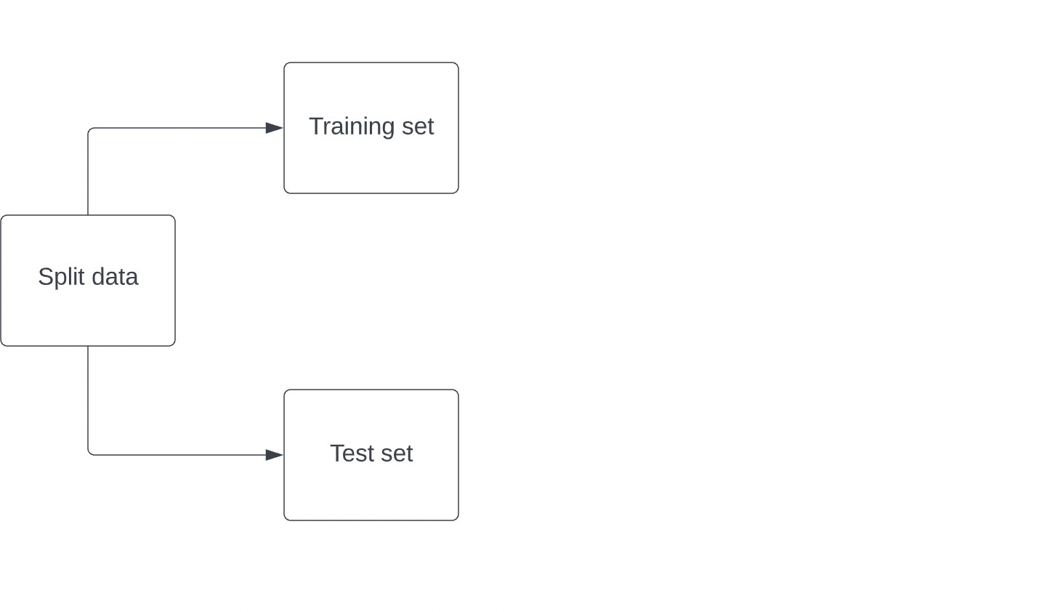
Computing accuracy

Slide 23
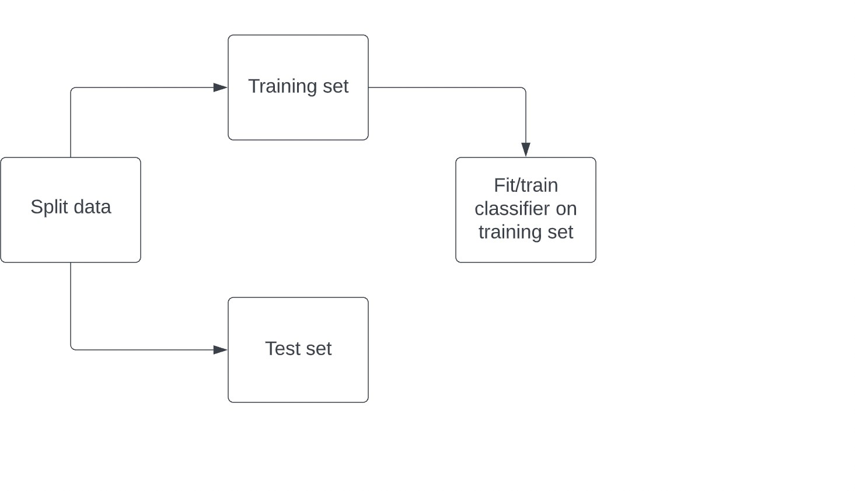
Computing accuracy

Slide 24
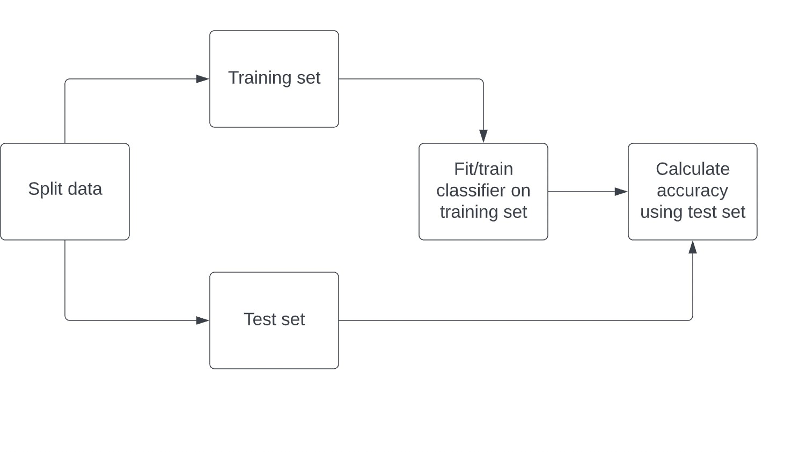
Computing accuracy

Slide 25
Train/test split
sklearn.model_selection train_test_split
X_train, X_test, y_train, y_test = train_test_split(X, y, test_size=0.3,
random_state=21, stratify=y)
knn = KNeighborsClassifier(n_neighbors=6) knn.fit(X_train, y_train) print(knn.score(X_test, y_test))
0.8800599700149925

Slide 26
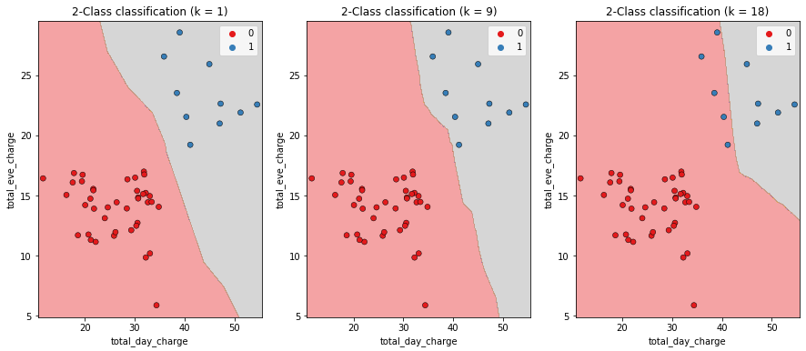
Model complexity
Larger k = less complex model = can cause underfitting Smaller k = more complex model = can lead to overfitting

Slide 27
Model complexity and over/underfitting
train_accuracies = {} test_accuracies = {} neighbors = np.arange(1, 26)
neighbor neighbors:
knn = KNeighborsClassifier(n_neighbors=neighbor) knn.fit(X_train, y_train)
train_accuracies[neighbor] = knn.score(X_train, y_train) test_accuracies[neighbor] = knn.score(X_test, y_test)

Slide 28
Plotting our results
plt.figure(figsize=(8, 6))
plt.title("KNN: Varying Number of Neighbors")
plt.plot(neighbors, train_accuracies.values(), label="Training Accuracy") plt.plot(neighbors, test_accuracies.values(), label="Testing Accuracy") plt.legend()
plt.xlabel("Number of Neighbors") plt.ylabel("Accuracy")
plt.show()

Slide 29
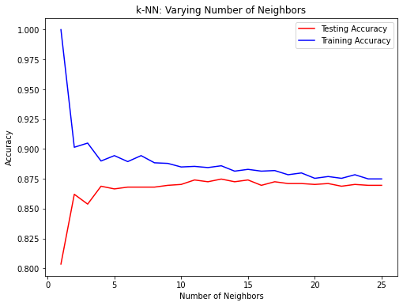
Model complexity curve

Slide 30

Model complexity curve

